Slide 1
Chapter 5
File Operations in Java

Slide 2
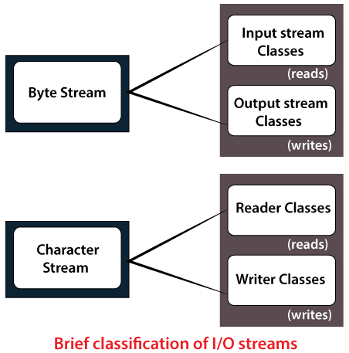
In Java, a File is an abstract data type. A named location used to store related information is known as a File. There are several File Operations like creating a new File, getting information about File, writing into a File, reading from a File and deleting a File.
Stream and File methods.
Stream: A series of data is referred to as a stream. In Java, Stream is classified into two types, i.e., Byte Stream and Character Stream.

Slide 3
Byte Stream
Byte Stream is mainly involved with byte data. A file handling process with a byte stream is a process in which an input is provided and executed with the byte data.
Character Stream
Character Stream is mainly involved with character data. A file handling process with a character stream is a process in which an input is provided and executed with the character data.

Slide 4
Java File Class Methods
1. | canRead() | Boolean | The canRead() method is used to check whether we can read the data of the file or not.
2. | createNewFile() | Boolean | The createNewFile() method is used to create a new empty file.
3. | canWrite() | Boolean | The canWrite() method is used to check whether we can write the data into the file or not.
4. | exists() | Boolean | The exists() method is used to check whether the specified file is present or not.
5. | delete() | Boolean | The delete() method is used to delete a file.
6. | getName() | String | The getName() method is used to find the file name.
7. | getAbsolutePath() | String | The getAbsolutePath() method is used to get the absolute pathname of the file.
8. | length() | Long | The length() method is used to get the size of the file in bytes.
9. | list() | String[] | The list() method is used to get an array of the files available in the directory.
10. | mkdir() | Boolean | The mkdir() method is used for creating a new directory.

Slide 5
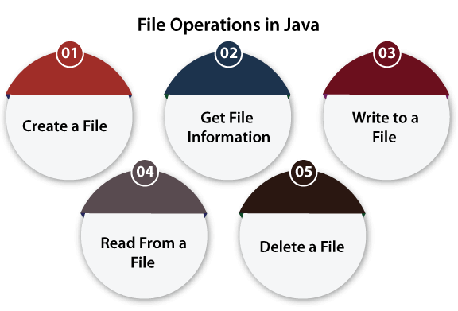
File Operations: We can perform the following operation on a file:
Create a File
Get File Information
Write to a File
Read from a File
Delete a File

Slide 6
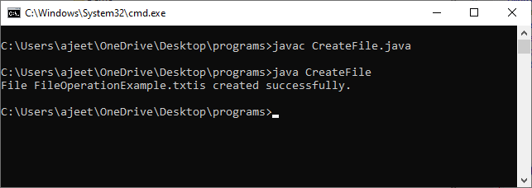
Create a File Create a File operation is performed to create a new file. We use the createNewFile() method of file. The createNewFile() method returns true when it successfully creates a new file and returns false when the file already exists.
// Importing File class
import java.io.File; // Importing the IOException class for handling errors
import java.io.IOException;
class CreateFile {
public static void main(String args[]) {
try { // Creating an object of a file
File f0 = new File("D:FileOperationExample.txt");
if (f0.createNewFile()) {
System.out.println("File " + f0.getName() + " is created successfully.");
} else {
System.out.println("File is already exist in the directory.");
}
} catch (IOException exception) {
System.out.println("An unexpected error is occurred.");
exception.printStackTrace();
} } }
In the above code, we import the File and IOException class for performing file operation and handling errors, respectively. We create the f0 object of the File class and specify the location of the directory where we want to create a file.
In the try block, we call the createNewFile() method through the f0 object to create a new file in the specified location. If the method returns false, it will jump to the else section. If there is any error, it gets handled in the catch block.

Slide 7
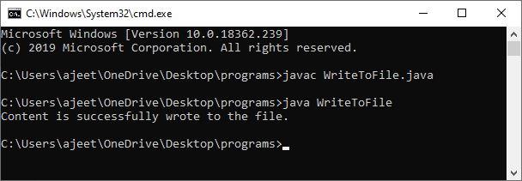
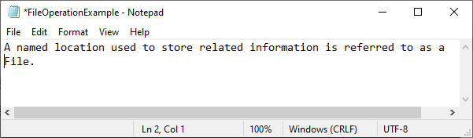
Write to a File The next operation which we can perform on a file is "writing into a file". In order to write data into a file, we will use the FileWriter class and its write() method together. We need to close the stream using the close() method to retrieve the allocated resources.
// Importing the FileWriter class
import java.io.FileWriter;
// Importing the IOException class for handling errors
import java.io.IOException;
class WriteToFile {
public static void main(String[] args) {
try {
FileWriter fwrite = new FileWriter("D:FileOperationExample.txt");
// writing the content into the FileOperationExample.txt file
fwrite.write("A named location used to store related information is referred to as a File.");
// Closing the stream
fwrite.close();
System.out.println("Content is successfully wrote to the file.");
} catch (IOException e) {
System.out.println("Unexpected error occurred");
e.printStackTrace();
} } }

Slide 8
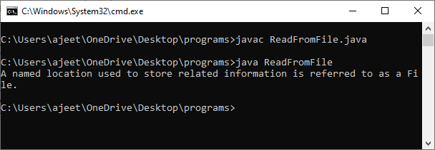
Read from a File The next operation which we can perform on a file is "read from a file". In order to write data into a file, we will use the Scanner class. Here, we need to close the stream using the close() method. We will create an instance of the Scanner class and use the hasNextLine() method nextLine() method to get data from the file.
// Importing the File class
import java.io.File;
// Importing FileNotFoundException class for handling errors
import java.io.FileNotFoundException;
// Importing the Scanner class for reading text files
import java.util.Scanner;
class ReadFromFile {
public static void main(String[] args) {
try { // Create f1 object of the file to read data
File f1 = new File("D:FileOperationExample.txt");
Scanner dataReader = new Scanner(f1);
while (dataReader.hasNextLine()) {
String fileData = dataReader.nextLine();
System.out.println(fileData);
}
dataReader.close();
} catch (FileNotFoundException exception) {
System.out.println("Unexcpected error occurred!");
exception.printStackTrace(); } } }

Slide 9
Java I/O (Input and Output) is used to process the input and produce the output.
Java uses the concept of a stream to make I/O operation fast. The java.io package contains all the classes required for input and output operations.
Stream
A stream is a sequence of data. In Java, a stream is composed of bytes. It's called a stream because it is like a stream of water that continues to flow.
In Java, 3 streams are created for us automatically. All these streams are attached with the console.
1) System.out: standard output stream
2) System.in: standard input stream
3) System.err: standard error stream
Let's see the code to print output and an error message to the console.
System.out.println("simple message");
System.err.println("error message");
Let's see the code to get input from console.
int i=System.in.read();//returns ASCII code of 1st character
System.out.println((char)i);//will print the character

Slide 10
OutputStream vs InputStream
OutputStream
Java application uses an output stream to write data to a destination; it may be a file, an array, peripheral device or socket.
InputStream
Java application uses an input stream to read data from a source; it may be a file, an array, peripheral device or socket.

Slide 11
OutputStream class OutputStream class is an abstract class. It is the superclass of all classes representing an output stream of bytes. An output stream accepts output bytes and sends them to some sink.
1) public void write(int)throws IOException | is used to write a byte to the current output stream.
2) public void write(byte[])throws IOException | is used to write an array of byte to the current output stream.
3) public void flush()throws IOException | flushes the current output stream.
4) public void close()throws IOException | is used to close the current output stream.

Slide 12
InputStream class InputStream class is an abstract class. It is the superclass of all classes representing an input stream of bytes.
1) public abstract int read()throws IOException | reads the next byte of data from the input stream. It returns -1 at the end of the file.
2) public int available()throws IOException | returns an estimate of the number of bytes that can be read from the current input stream.
3) public void close()throws IOException | is used to close the current input stream.

Slide 13
Java FileOutputStream Class
Method | Description
protected void finalize() | It is used to clean up the connection with the file output stream.
void write(byte[] ary) | It is used to write ary.length bytes from the byte array to the file output stream.
void write(byte[] ary, int off, int len) | It is used to write len bytes from the byte array starting at offset off to the file output stream.
void write(int b) | It is used to write the specified byte to the file output stream.
FileChannel getChannel() | It is used to return the file channel object associated with the file output stream.
FileDescriptor getFD() | It is used to return the file descriptor associated with the stream.
void close() | It is used to closes the file output stream.
Java FileOutputStream is an output stream used for writing data to a file.
If you have to write primitive values into a file, use FileOutputStream class. You can write byte-oriented as well as character-oriented data through FileOutputStream class. But, for character-oriented data, it is preferred to use FileWriter than FileOutputStream.
FileOutputStream class declaration
Let's see the declaration for Java.io.FileOutputStream class:
public class FileOutputStream extends OutputStream

Slide 14
Java FileOutputStream Example 1: write byte
Java FileOutputStream example 2: write string
import java.io.FileOutputStream;
public class FileOutputStreamExample {
public static void main(String args[]){
try{
FileOutputStream fout=new FileOutputStream("D:\\testout.txt");
String s="Welcome to javaTpoint.";
byte b[]=s.getBytes();//converting string into byte array
fout.write(b);
fout.close();
System.out.println("success...");
}catch(Exception e){System.out.println(e);}
}
}
Output:
Success...
The content of a text file testout.txt is set with the data Welcome to javaTpoint.
testout.txt
Welcome to javaTpoint.N
import java.io.FileOutputStream;
public class FileOutputStreamExample {
public static void main(String args[]){
try{
FileOutputStream fout=new FileOutputStream("D:\\testout.txt");
fout.write(65);
fout.close();
System.out.println("success...");
}catch(Exception e){System.out.println(e);} } }
Success...
The content of a text file testout.txt is set with the data A.
testout.txt
A

Slide 15
Java FileInputStream Class
Java FileInputStream class obtains input bytes from a file. It is used for reading byte-oriented data (streams of raw bytes) such as image data, audio, video etc. You can also read character-stream data. But, for reading streams of characters, it is recommended to use FileReader class.
Java FileInputStream class declaration java.io.FileInputStream class:
public class FileInputStream extends InputStream
Method | Description
int available() | It is used to return the estimated number of bytes that can be read from the input stream.
int read() | It is used to read the byte of data from the input stream.
int read(byte[] b) | It is used to read up to b.length bytes of data from the input stream.
int read(byte[] b, int off, int len) | It is used to read up to len bytes of data from the input stream.
long skip(long x) | It is used to skip over and discards x bytes of data from the input stream.
FileChannel getChannel() | It is used to return the unique FileChannel object associated with the file input stream.
FileDescriptor getFD() | It is used to return the FileDescriptor object.
protected void finalize() | It is used to ensure that the close method is call when there is no more reference to the file input stream.
void close() | It is used to closes the stream.

Slide 16
Java FileInputStream example 1: read single character
import java.io.FileInputStream;
public class DataStreamExample {
public static void main(String args[]){
try{
FileInputStream fin=new FileInputStream("D:\\testout.txt");
int i=fin.read();
System.out.print((char)i);
fin.close();
}catch(Exception e){System.out.println(e);}
}
}
Note: Before running the code, a text file named as "testout.txt" is required to be created. In this file, we are having following content:
Welcome to javatpoint.
Output:
W
Java FileInputStream example 2: read all characters
package com.javatpoint;
import java.io.FileInputStream;
public class DataStreamExample {
public static void main(String args[]){
try{
FileInputStream fin=new FileInputStream("D:\\testout.txt");
int i=0;
while((i=fin.read())!=-1){
System.out.print((char)i);
}
fin.close();
}catch(Exception e){System.out.println(e);}
}
}
Output:
Welcome to javaTpoint

Slide 17
Java DataOutputStream Class
int size() | It is used to return the number of bytes written to the data output stream.
void write(int b) | It is used to write the specified byte to the underlying output stream.
void write(byte[] b, int off, int len) | It is used to write len bytes of data to the output stream.
void writeBoolean(boolean v) | It is used to write Boolean to the output stream as a 1-byte value.
void writeChar(int v) | It is used to write char to the output stream as a 2-byte value.
void writeChars(String s) | It is used to write string to the output stream as a sequence of characters.
void writeByte(int v) | It is used to write a byte to the output stream as a 1-byte value.
void writeBytes(String s) | It is used to write string to the output stream as a sequence of bytes.
void writeInt(int v) | It is used to write an int to the output stream
void writeShort(int v) | It is used to write a short to the output stream.
void writeShort(int v) | It is used to write a short to the output stream.
void writeLong(long v) | It is used to write a long to the output stream.
void writeUTF(String str) | It is used to write a string to the output stream using UTF-8 encoding in portable manner.
void flush() | It is used to flushes the data output stream.
Java DataOutputStream class allows an application to write primitive Java data types to the output stream in a machine-independent way.
Java application generally uses the data output stream to write data that can later be read by a data input stream.
Java DataOutputStream class declaration
Let's see the declaration for java.io.DataOutputStream class:
public class DataOutputStream extends FilterOutputStream implements DataOutput

Slide 18
Example of DataOutputStream class In this example, we are writing the data to a text file testout.txt using DataOutputStream class.
package com.javatpoint;
import java.io.*;
public class OutputExample {
public static void main(String[] args) throws IOException {
FileOutputStream file = new FileOutputStream(D:\\testout.txt);
DataOutputStream data = new DataOutputStream(file);
data.writeInt(65);
data.flush();
data.close();
System.out.println("Succcess...");
}
}
Output:
Succcess...
testout.txt:
A

Slide 19
Java DataInputStream Class
int read(byte[] b) | It is used to read the number of bytes from the input stream.
int read(byte[] b, int off, int len) | It is used to read len bytes of data from the input stream.
int readInt() | It is used to read input bytes and return an int value.
byte readByte() | It is used to read and return the one input byte.
char readChar() | It is used to read two input bytes and returns a char value.
double readDouble() | It is used to read eight input bytes and returns a double value.
boolean readBoolean() | It is used to read one input byte and return true if byte is non zero, false if byte is zero.
int skipBytes(int x) | It is used to skip over x bytes of data from the input stream.
String readUTF() | It is used to read a string that has been encoded using the UTF-8 format.
void readFully(byte[] b) | It is used to read bytes from the input stream and store them into the buffer array.
void readFully(byte[] b, int off, int len) | It is used to read len bytes from the input stream.
Java DataInputStream class allows an application to read primitive data from the input stream in a machine-independent way.
Java application generally uses the data output stream to write data that can later be read by a data input stream. Java DataInputStream class declaration
declaration for java.io.DataInputStream class:
public class DataInputStream extends FilterInputStream implements DataInput

Slide 20
DataInputStream class
package com.javatpoint;
import java.io.*;
public class DataStreamExample {
public static void main(String[] args) throws IOException {
InputStream input = new FileInputStream("D:\\testout.txt");
DataInputStream inst = new DataInputStream(input);
int count = input.available();
byte[] ary = new byte[count];
inst.read(ary);
for (byte bt : ary) {
char k = (char) bt;
System.out.print(k+"-");
}
}
}
JAVA
Output:
J-A-V-A

Slide 21
Java FileWriter Class
Java FileWriter class declaration
Let's see the declaration for Java.io.FileWriter class:
public class FileWriter extends OutputStreamWriter
Constructors of FileWriter class
Constructor Description
FileWriter(String file) Creates a new file. It gets file name in string.
FileWriter(File file) Creates a new file. It gets file name in File object.
Java FileWriter class is used to write character-oriented data to a file. It is character-oriented class which is used for file handling in java.
Unlike FileOutputStream class, you don't need to convert string into byte array because it provides method to write string directly.

Slide 22
package com.javatpoint;
import java.io.FileWriter;
public class FileWriterExample {
public static void main(String args[]){
try{
FileWriter fw=new FileWriter("D:\\testout.txt");
fw.write("Welcome to javaTpoint.");
fw.close();
}catch(Exception e){System.out.println(e);}
System.out.println("Success...");
}
}
Output:
Success...
testout.txt:
Welcome to javaTpoint.
Method | Description
void write(String text) | It is used to write the string into FileWriter.
void write(char c) | It is used to write the char into FileWriter.
void write(char[] c) | It is used to write char array into FileWriter.
void flush() | It is used to flushes the data of FileWriter.
void close() | It is used to close the FileWriter.

Slide 23
Java FileReader Class
Java FileReader class is used to read data from the file. It returns data in byte format like FileInputStream class.
It is character-oriented class which is used for file handling in java.
Java FileReader class declaration
Let's see the declaration for Java.io.FileReader class:
public class FileReader extends InputStreamReader
Constructor | Description
FileReader(String file) | It gets filename in string. It opens the given file in read mode. If file doesn't exist, it throws FileNotFoundException.
FileReader(File file) | It gets filename in file instance. It opens the given file in read mode. If file doesn't exist, it throws FileNotFoundException.

Slide 24
package com.javatpoint;
import java.io.FileReader;
public class FileReaderExample {
public static void main(String args[])throws Exception{
FileReader fr=new FileReader("D:\\testout.txt");
int i;
while((i=fr.read())!=-1)
System.out.print((char)i);
fr.close();
}
}
Here, we are assuming that you have following data in "testout.txt" file:
Welcome to javaTpoint.
Output:
Welcome to javaTpoint.
Method | Description
int read() | It is used to return a character in ASCII form. It returns -1 at the end of file.
void close() | It is used to close the FileReader class.

Slide 25
Java File Class The File class is an abstract representation of file and directory pathname. A pathname can be either absolute or relative. Fields
static | String | pathSeparator | It is system-dependent path-separator character, represented as a string for convenience.
static | char | pathSeparatorChar | It is system-dependent path-separator character.
static | String | separator | It is system-dependent default name-separator character, represented as a string for convenience.
static | char | separatorChar | It is system-dependent default name-separator character.
Constructor | Description
File(File parent, String child) | It creates a new File instance from a parent abstract pathname and a child pathname string.
File(String pathname) | It creates a new File instance by converting the given pathname string into an abstract pathname.
File(String parent, String child) | It creates a new File instance from a parent pathname string and a child pathname string.
File(URI uri) | It creates a new File instance by converting the given file: URI into an abstract pathname.

Slide 26
Modifier and Type | Method | Description
static File | createTempFile(String prefix, String suffix) | It creates an empty file in the default temporary-file directory, using the given prefix and suffix to generate its name.
boolean | createNewFile() | It atomically creates a new, empty file named by this abstract pathname if and only if a file with this name does not yet exist.
boolean | canWrite() | It tests whether the application can modify the file denoted by this abstract pathname.String[]
boolean | canExecute() | It tests whether the application can execute the file denoted by this abstract pathname.
boolean | canRead() | It tests whether the application can read the file denoted by this abstract pathname.
boolean | isAbsolute() | It tests whether this abstract pathname is absolute.
boolean | isDirectory() | It tests whether the file denoted by this abstract pathname is a directory.
boolean | isFile() | It tests whether the file denoted by this abstract pathname is a normal file.

Slide 27
Java File Example 1
import java.io.*;
public class FileDemo {
public static void main(String[] args) {
try {
File file = new File("javaFile123.txt");
if (file.createNewFile()) {
System.out.println("New File is created!");
} else {
System.out.println("File already exists.");
}
} catch (IOException e) {
e.printStackTrace();
}
}
}
Output:
New File is created!
Java File Example 2
import java.io.*;
public class FileDemo2 {
public static void main(String[] args) {
String path = "";
boolean bool = false;
try { // createing new files
File file = new File("testFile1.txt");
file.createNewFile();
System.out.println(file); // createing new canonical from file object
File file2 = file.getCanonicalFile(); // returns true if the file exists
System.out.println(file2);
bool = file2.exists(); // returns absolute pathname
path = file2.getAbsolutePath();
System.out.println(bool); // if file exists
if (bool) { // prints
System.out.print(path + " Exists? " + bool);
}
} catch (Exception e) { // if any error occurs
e.printStackTrace();
} } }
Output:

Slide 28
Java Console Class

